Slide 1
1903 - SIMULATION OF ISLANDING IN DISTRIBUTION NETWORKS
Dr. Attila KOVÁCS Astron Informatics Ltd., Hungary | Róbert GAÁL Astron Informatics Ltd., Hungary | János CSATÁR Budapest University of Technology, Hungary
HW network
ANM Regulator
HV/MV Substation
HV/MV Substation
Cooperation between DSO and Microgrid
Island 3
Other Traditional Consumers
+
-
Distribution Network
Mini renew.
Power Plant
Central Battery
Island 2
Case Study 3:
In case of outages in high voltage network central mini power plant and battery supplies the medium voltage network and the Microgrid supports the Voltage – VAR regulation
Village
Farm
Island 1
Case Study 2:
Microgrid decreases the not supplied energy in the outaged part of network (Village, Farm)
Case Study 1:
Maximizing the utilization of renewable energy in Microgrid OR island operation mode when the Microgrid behaves as a small energy system. (P-f, U-Q regulation)
Microgrid
Microgrid Regulator
+
-

Slide 2
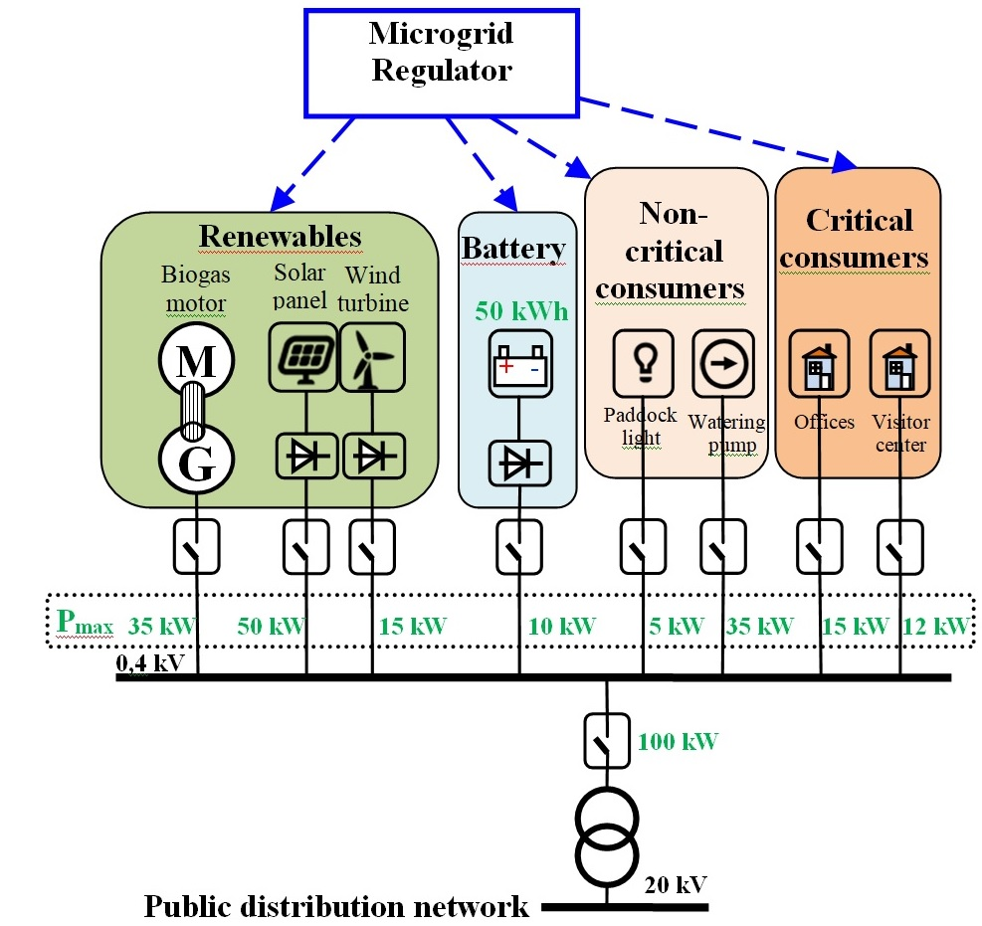
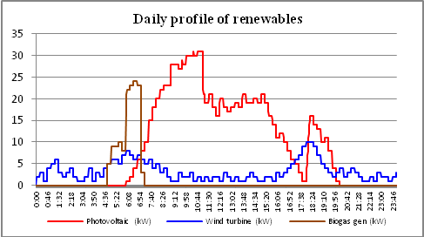
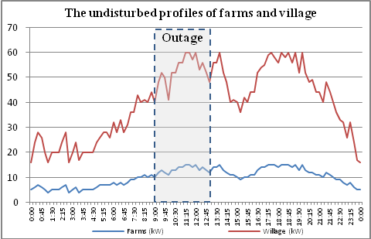
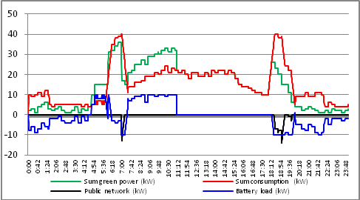
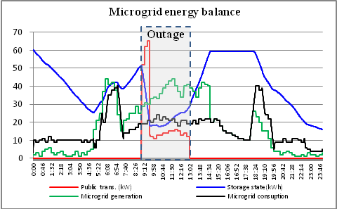
1903 - SIMULATION OF ISLANDING IN DISTRIBUTION NETWORKS
Dr. Attila KOVÁCS Astron Informatics Ltd., Hungary | Róbert GAÁL Astron Informatics Ltd., Hungary | János CSATÁR Budapest University of Technology, Hungary
Model of Microgrid
Case Study 1:
Maximizing the utilization of renewable energy in Microgrid OR island operation mode when the Microgrid behaves as a small energy system. (P-f, U-Q regulation)
Case Study 2:
Microgrid decreases the not supplied energy in the outaged part of network (Village, Farm)

Slide 3
1903 - SIMULATION OF ISLANDING IN DISTRIBUTION NETWORKS
Dr. Attila KOVÁCS Astron Informatics Ltd., Hungary | Róbert GAÁL Astron Informatics Ltd., Hungary | János CSATÁR Budapest University of Technology, Hungary
Experimental setup, simulator architecture
per-phase, special load-flow
single-node effective power-frequency model
simulator engine for controlling model computations
Simulator engine
Simulation time
Signal distribution
INPUT
Generator
OUTPUT
G
INPUT
Solar panels
OUTPUT
Device models
INPUT
Water turb.
OUTPUT
INPUT
Wind turb.
OUTPUT
INPUT
Battery
OUTPUT
INPUT
Consumers
OUTPUT
Load-flow calculation
P-f
modelling
Electrical calc. func.
Conditional Events
Scenarios
Simulator functions

